Slide 1


Object-Oriented Programming
Vehicles
Deep Mind team
by Krishnakanth Yachareni
Srinivas Chintakindhi
February 12, 2018

Slide 2
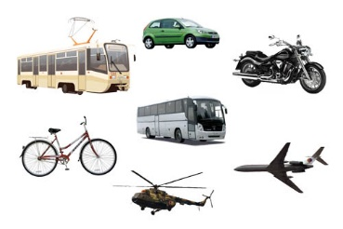
Object-Oriented Programming
Vehicles
Contents
1. Objective
2. Task Description
3. High Level Design
4. Flow Chart

Slide 3
Objective
Designing an application that finds the vehicle in a text file and create an appropriate object saving all information about that vehicle.

Slide 4
Task Description
Vehicles application can accept the input from user then it reads the respective data from the file.
There are many types of vehicles in the file: trucks, passenger cars, bikes, scooters etc. Each of them has own properties and it requires designing a class hierarchy.
Based on the input should create appropriate vehicle object and displaying the vehicle information on to the console.

Slide 5
High Level Diagram
Vehicle Hierarchy
Class Name validator
Create the vehicle instances
Class name validating
User IO
No command Found Exception
Sends the key
Service Manager
Raise Exception
Search Vehicle
Send vehicle properties
Return vehicle Object
Read data
Vehicles Property File

Slide 6
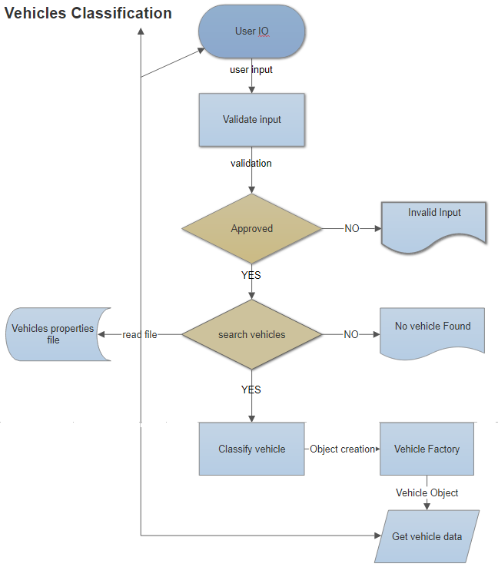
Flow Chart

Slide 7
Thank you

